Slide 1


Introduction to Bash Shell Scripting
Fondren Library
Digital Scholarship Services

Slide 2
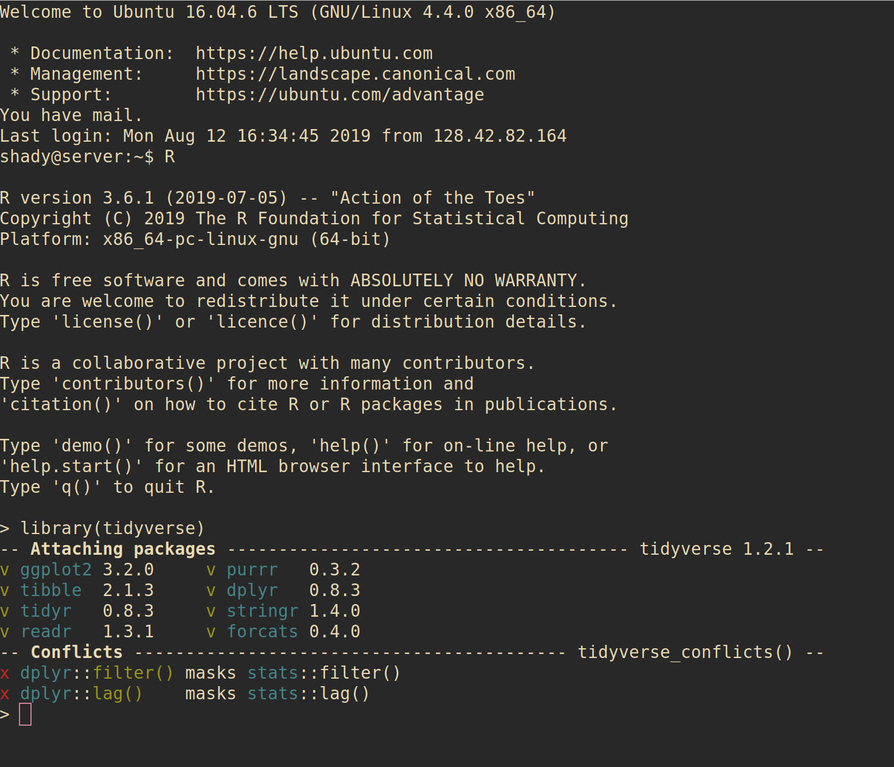
WHAT IS A SHELL?
Most simple interface to an operating system
Allows easy execution of programs and file operations
Highly configurable without needing to sort through massive menus
Fast and lightweight

Slide 3
WHAT IS BASH?
Bourne-Again Shell
Play on words: Stephen Bourne wrote the initial Unix shell
Improved on Bourne shell (sh)
More features, better builtins
Completely free and open-source for all platforms, licensed under the GNU public license

Slide 4
HOW DO I GET BASH?
On Unix-based platforms (Mac OS, Linux, etc) it will almost always be installed by default
Windows (the only major non-Unix-based OS):
Install minGW (minimalist GNU for Windows)
Make sure to select the msys developer kit!

Slide 5
WHEN DO I USE BASH?
Versus Scripting Languages (e.g. Perl, Python, Ruby, Lua)
Bash allows simpler access to commands with extensive shell-specific features, often unsupported by scripting languages
Scripting languages are usually easier to program in but don’t interface seamlessly with the OS
Versus a Visual Environment
Often with remote servers, you have to use a terminal
Visual environments are great for quickly looking through file structures
Shell environments are great if you want to run any slightly advanced query (find operations, etc) and for programming

Slide 6
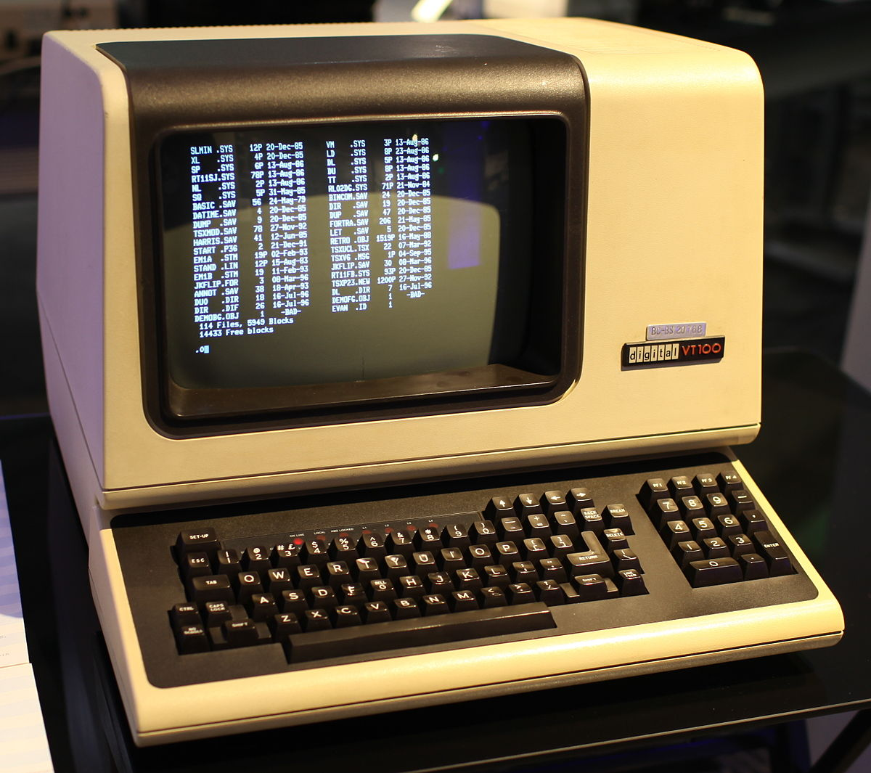
A LITTLE HISTORY
Before the advent of Microsoft Windows (1981) and Mac OS (1984) and their desktop environments, terminals were the only option!
Unix was the most used, developed by Bell Labs at AT&T
Unix adapted by Linus Torvalds into Linux, and enjoyed Free Software Movement support

Slide 7
SHELL BASICS
A quick walkthrough of the environment

Slide 8
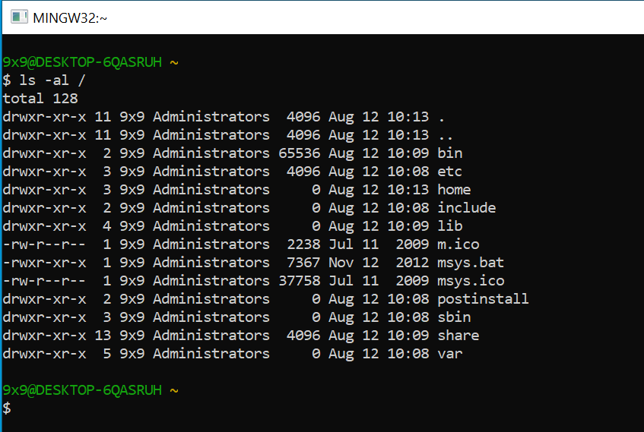
ANATOMY OF A SHELL
Prompt: what you see when you open the shell or finish a command
Waits for you to enter something
USER@COMPUTER (Directory)
$ (type commands here)
completely configurable, though
Command
Output

Slide 9
COMMANDS
First: an executable program
Anything from word.exe to simply listing the directory
Any number of arguments
Filenames, command line switches
example: ls –al Documents/
ls is a program that lists the current directory
-al are two separate arguments that show hidden files and permissions
Documents/ is a folder in the current directory we want the get the contents of

Slide 10
ENVIRONMENT
Several environment variables
PWD (print working directory)
PATH (where to look for executable files)
Many more (if you’re curious, type in env!)
This is how we can keep track of our state
Note that on Windows (more accurately NTFS/FAT file systems) case does not matter (File.txt is the same as filE.tXt), but on Linux (ext4) case matters

Slide 11
FILES
Special file shortcuts in bash
.-> This directory
.. -> Parent directory
~ -> User’s home directory
/ -> System root
Just type a few characters of the file then press tab to autocomplete!
Permissions: read, write, and execute
Any file can be executed!

Slide 12
CONFIGURATION
Making your shell look and act its best!

Slide 13
COLORS
Modern shells have support for colors
Great for distinguishing between file types (directory versus program versus document)

Slide 14
PROMPTS
Making your shell look and act its best!

Slide 15
ACKNOWLEDGMENTS
The Bash Logo is licensed for free use under the Copyleft license.
The bash screenshot on Slide 2 is R and Bash running under a Remmina connection.
The picture on Slide 6 is licensed under Creative Commons Attribution-ShareAlike 4.0 International, created by Gorthmog

